Slide 1
CI/CD PIPELINES
Foundational Pillar to reach the market faster

Slide 2
AGENDA
CI/CD What? Why? How?
Stakeholders' language
Some CI/CD tools
Summary
Resources and Questions

Slide 3
CI/CD PIPELINES
WHAT?

Slide 4
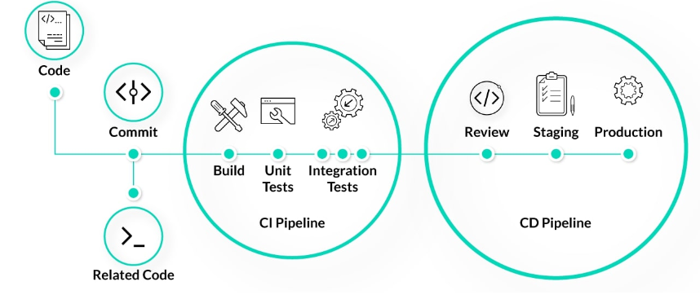
WHAT IS CI/CD?
Continuous Integration
Continuous Deployment
Continuous Delivery

Slide 5
CI/CD PIPELINES
WHY?

Slide 6
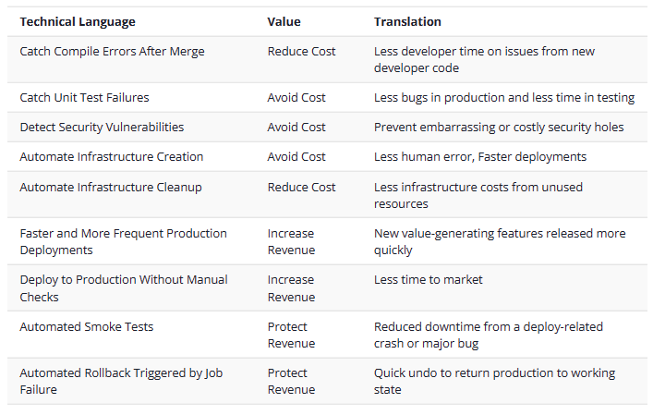
Why implement ci/cd pipelines?

Slide 7
CI/CD PIPELINES
HOW?

Slide 8

CI/cd best practices

Slide 9
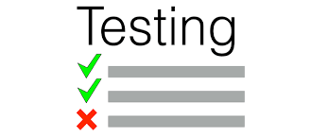

CI/CD best practices

Slide 10
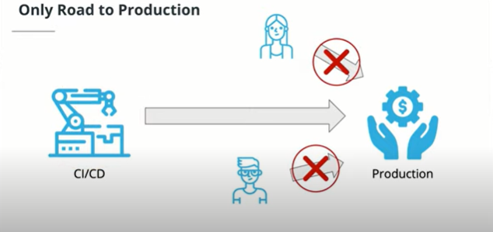
CI/CD BEST PRACTICES

Slide 11
"iF it can be automated, automate it."

Slide 12
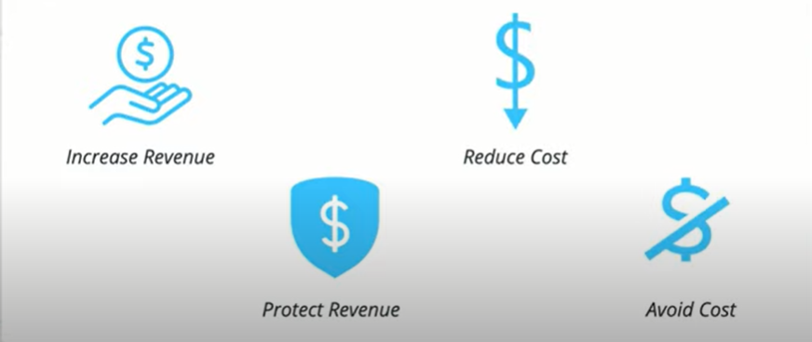
Speaking stakeholders' language

Slide 13




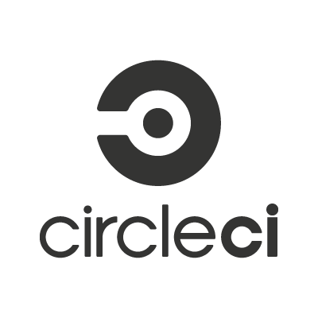


CI/CD TOOLS
Jenkins
Gitlab Community
Team City
Team Foundation Server
Open Source
Gitlab
JetBrains
Microsoft
Bamboo
Gitlab
Circle CI
Atlassian
Gitlab
Travis CI
Circle Internet Services

Slide 14
SUMMARY
As a foundation pillar of DevOps, we managed to know what is CI/CD, why do we need CI/CD and how to implement it.
In the end we had a quick overview of some CI/CD tools.

Slide 15
RESOURCES
R1
https://www.atlassian.com/
R2
https://www.digitalocean.com
R3
https://www.learn.udacity.com
R4
https://www.aws.amazon.com/

Slide 16
THANK YOU
Your questions are more than welcome
Abdelrahman Alaa Eldeen

